Slide 1
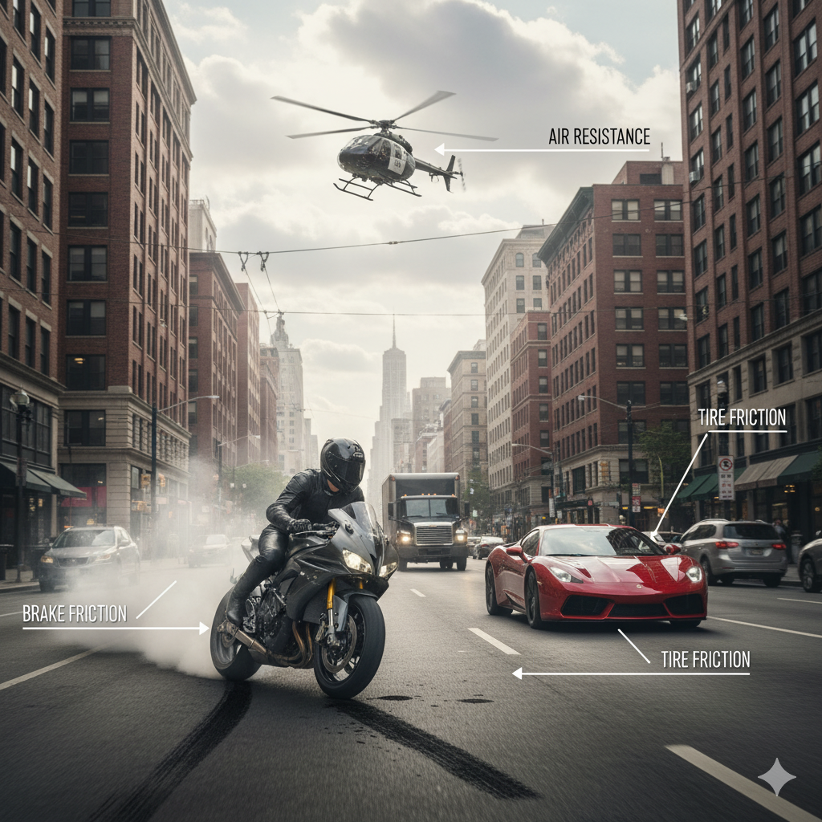
INTRODUCTION TO FRICTION
Friction is a force that slows down or stops the movement of objects when they touch another surface. It happens because surfaces are not perfectly smooth. Friction always works in the opposite direction of motion. It is useful in our daily life, like walking or stopping a vehicle, but too much friction can damage surfaces and waste energy.

Slide 2
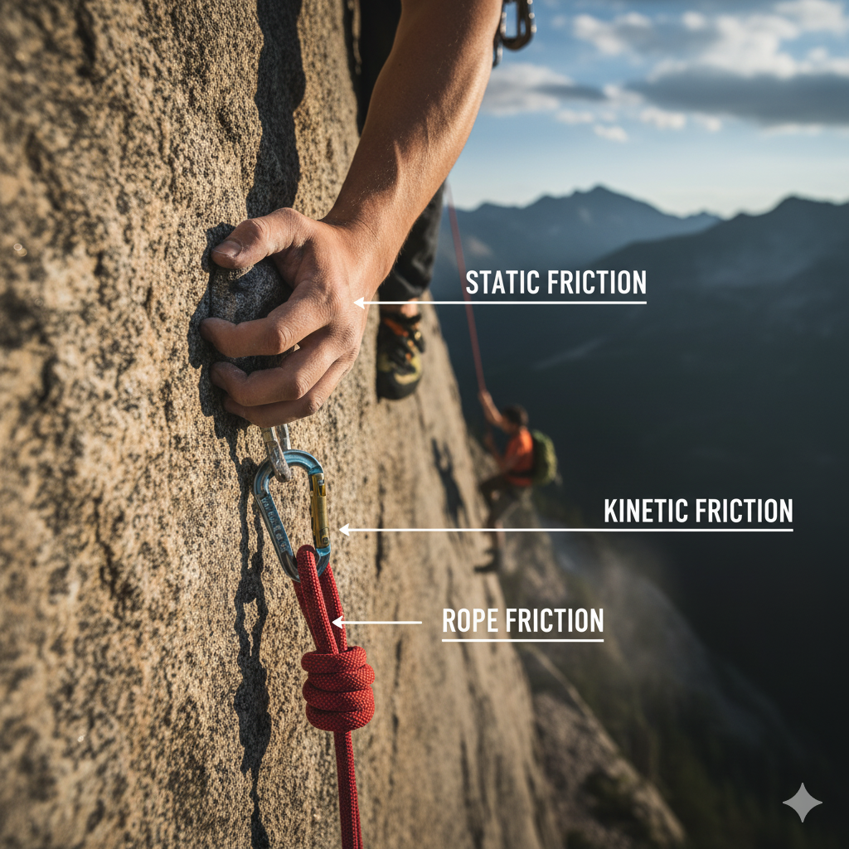
Classification of Friction
Static Friction: Friction when surfaces are in contact but not moving.
2. Kinetic Friction: Friction during sliding motion.
3. Rolling Friction: Friction when an object rolls over a surface.
4. Fluid Friction: Friction in liquids or gases.
5. Dry Friction: Friction between solid surfaces without lubrication.
6. Lubricated Friction: Friction between surfaces with a lubricant applied.

Slide 3
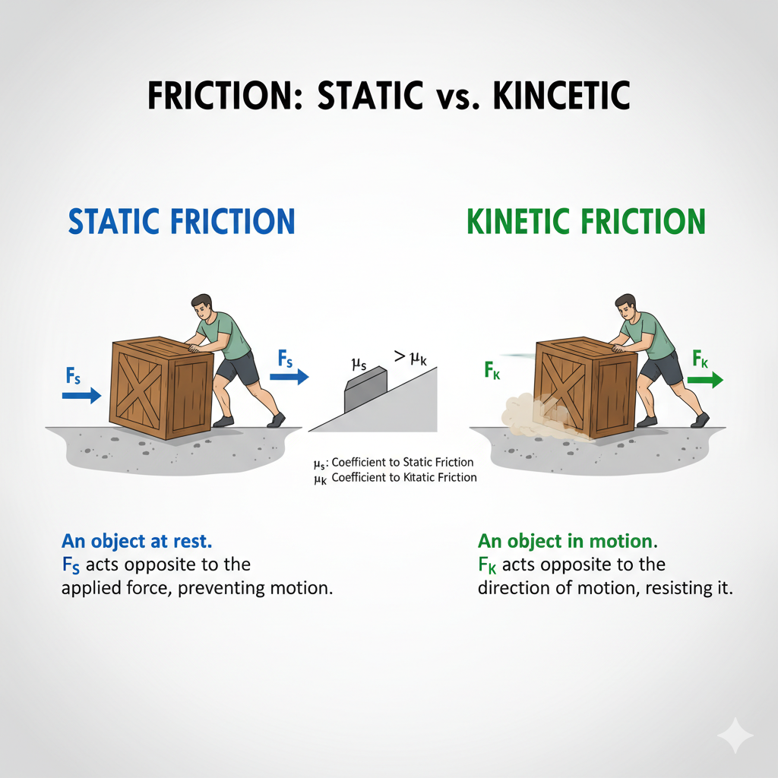
STATIC FRICTION (BEFORE MOVEMENT STARTS)
• This friction acts when an object is not moving.
• It prevents the object from starting to move.
Example: When you try to push a heavy box on the floor, at first it doesn’t move. This is because static friction is strong
Kinetic Friction(During Motion)
• This friction acts when an object already sliding or moving.
• That’s why once an object starts moving, it is easier to keep it moving.
Example: Once the box starts sliding, you feel it is easier to push. Now kinetic friction is acting, which is weaker

Slide 4
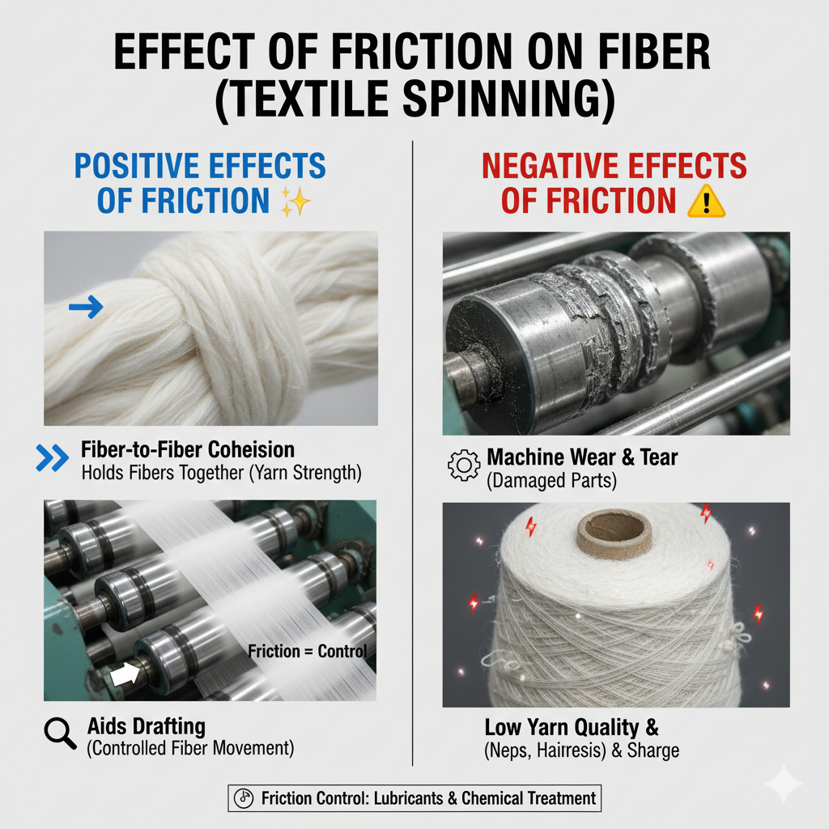
Friction helps fibers hold each other, so they do not slip away.
• If friction is higher, the fibers stick together better, and the yarn becomes stronger.
Moderate friction gives:
• Better control during spinning
• Less fiber slipping
• Smooth and even yarn
High Friction gives:
• Smooth fibers can get damaged.
• The yarn may become rough and weak

Slide 5
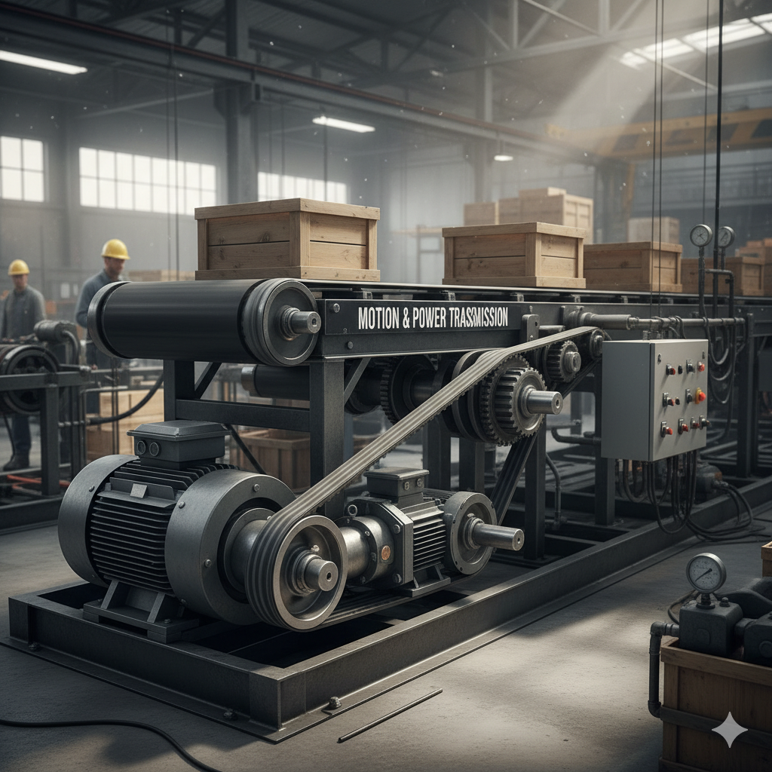
need to move and work together
Of machine to another
another gear turn
happen
wheels so the car can move.
part to another
distance (like bike chains)
reducing friction
Mechanics have many parts, and these parts
Motion Transmission
This means moving motion from one part
Example: One gear turns, and it makes
2. Power Transmission
This means sending energy to make work
Example: A car engine gives power to the
Systems that help in transmission
Gears → transfer motion from one rotating
Belts and Chains → transfer motion over a
Bearings → help parts move smoothly by

Slide 6
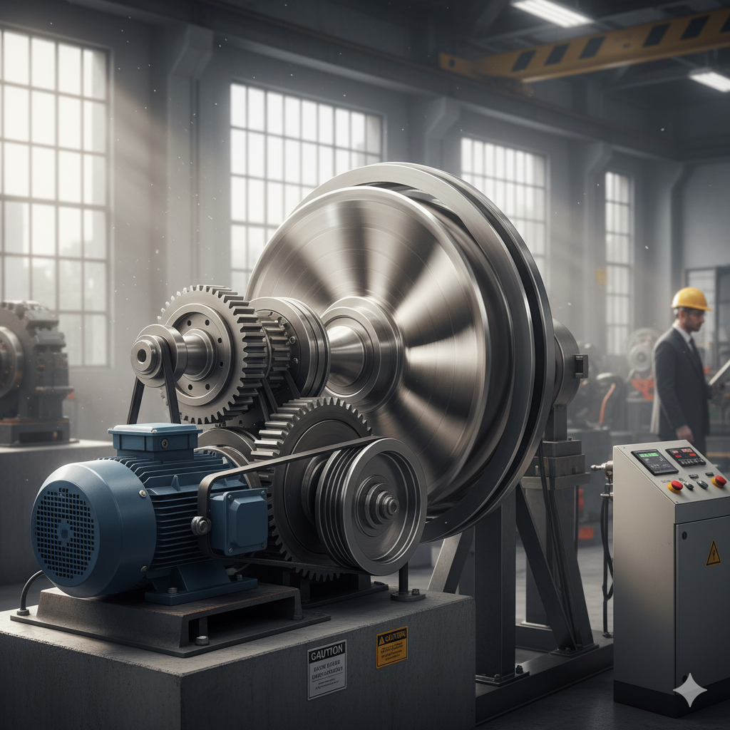
Rotational Motion
Rotational motion occurs when an object spins or turns around a fixed axis.
Key Concepts:
Axis of rotation: Line about which rotation occurs
Angular velocity (ω):Rate of rotation (radians/sec)
Angular acceleration (α):Change in angular velocity over time
Examples:
Spinning wheel
Rotating ceiling fan
Earth rotating on its axis

Slide 7
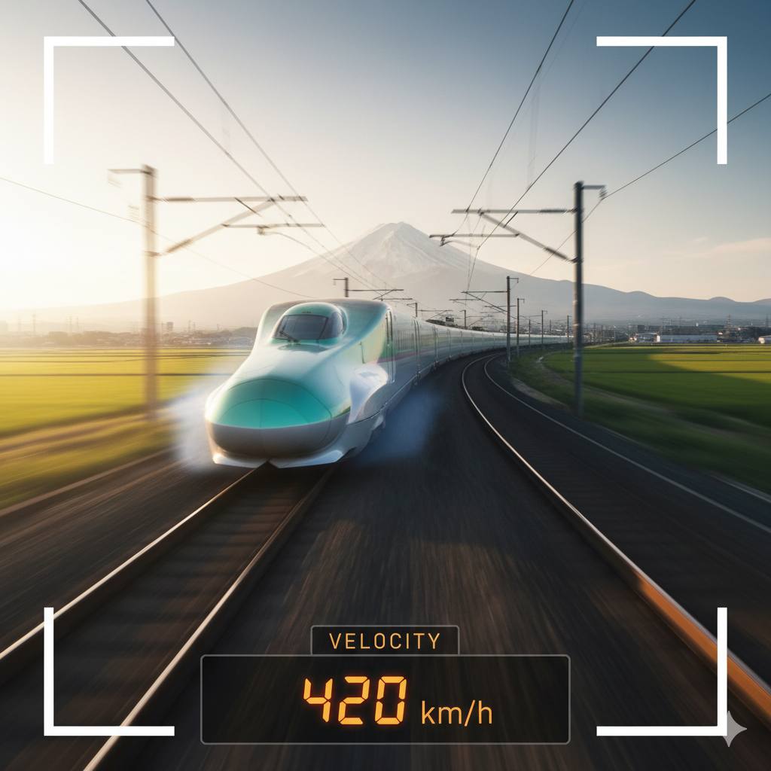

Speed
Key Points:
Scalar quantity (no direction)
Depends on distance and time
Example
Speed Example 1 (High-Speed Train): A high-speed train (like a Shinkansen) travelling at 320 km/h between cities.
Speed Example 2 (Rocket Launch): A launching rocket accelerating to thousands of kilometers per hour to escape Earth's gravity.

Slide 8
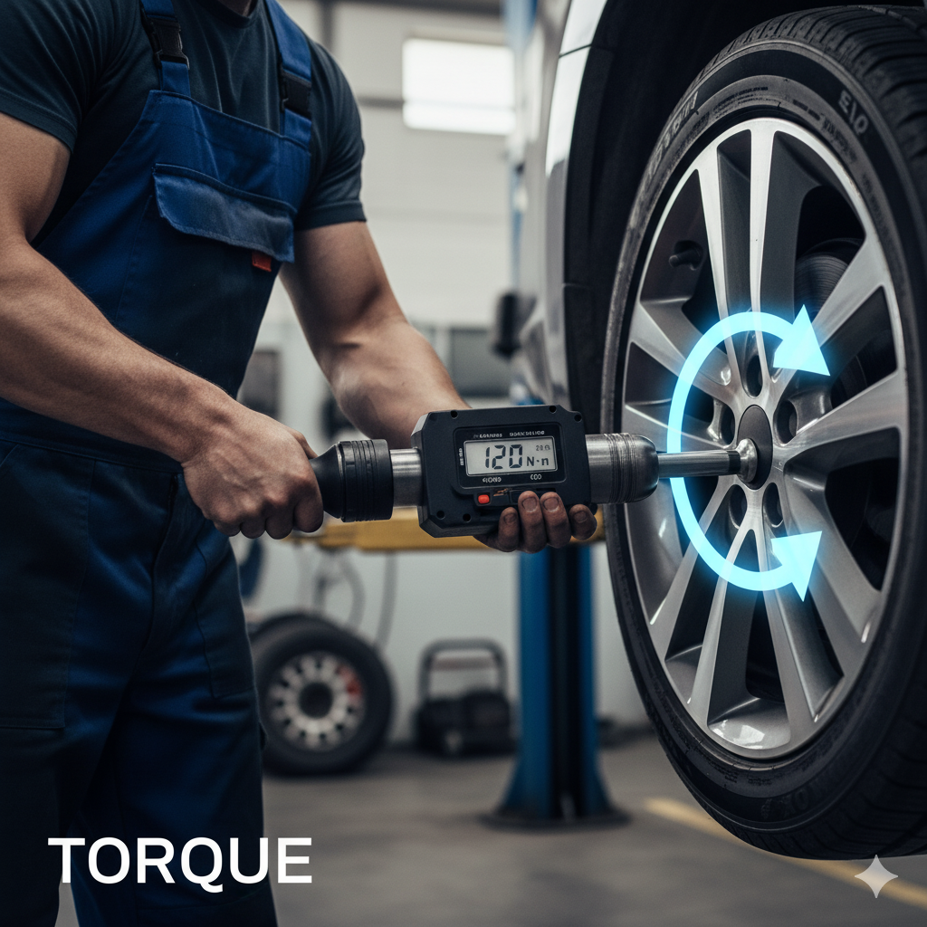
Torque
Torque is the *rotational effect of a force* applied at a distance from the pivot point.
Key Idea: Greater force or longer lever arm = higher torque \
Examples:
* Turning a wrench
* Opening a door
* Bicycle pedal rotation

Slide 9
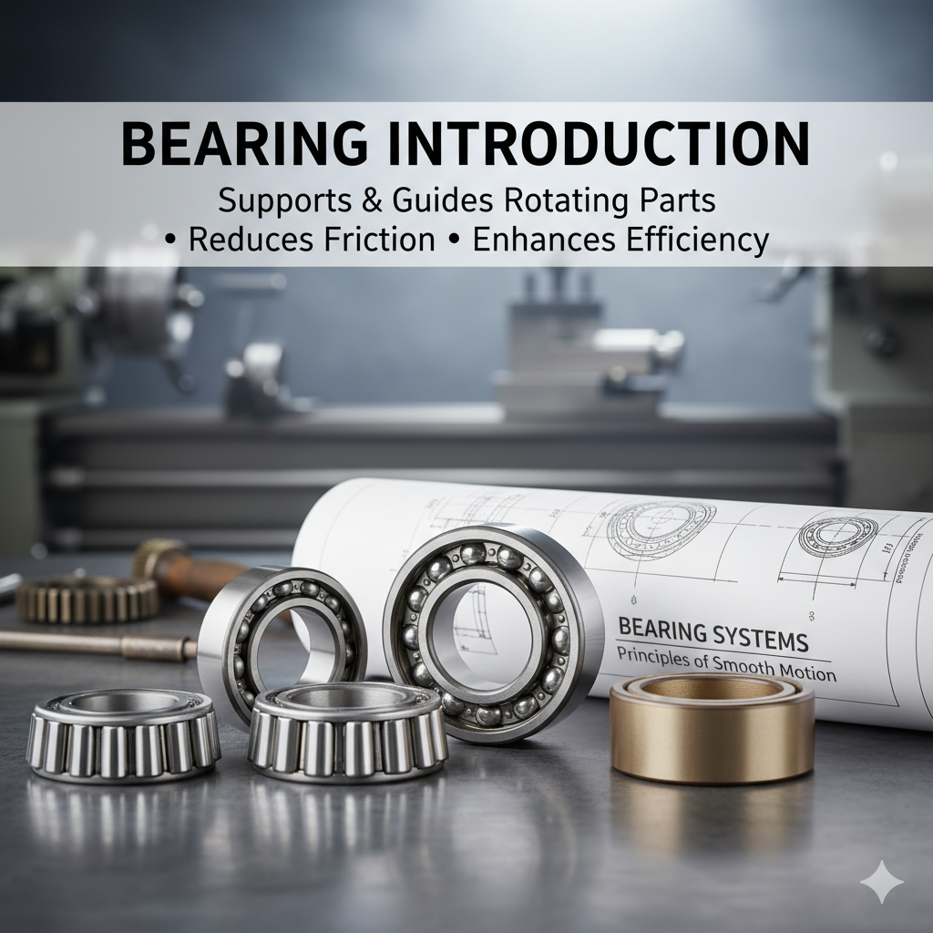
A bearing is a mechanical component that supports and guides rotating or moving parts, reducing friction between surfaces. Bearings are essential in machinery as they enable smooth motion and enhance operational efficiency. They come in various types such as ball bearings, roller bearings, and plain bearings
Key Points:
• A bearing is a mechanical element that supports and guides rotating parts.
• It reduces friction between moving surfaces.
• Ensures smooth motion and enhances operational efficiency.
• Types include ball bearings, roller bearings, and plain bearings.
• Used widely in all kinds of machinery and vehicles

Slide 10
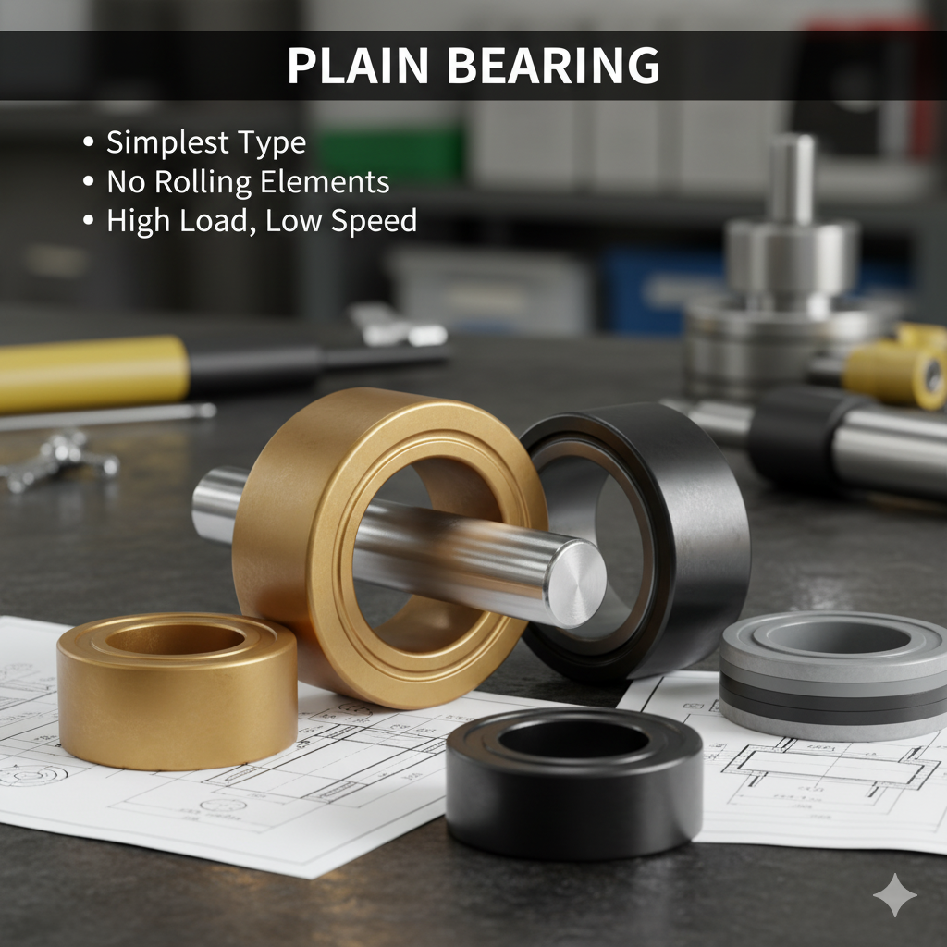
A plain bearing, also known as a bush or sleeve bearing, is the simplest type of bearing. It consists of a smooth surface on which the shaft rotates. There are no rolling elements in a plain bearing. They are often made from materials like bronze, plastic, or composite materials. Plain bearings are used where low speed and high load capacity are required
Important Features:
• Simplest type of bearing – no rolling elements.
• Consists of a smooth surface where the shaft rotates.
• Made from bronze, plastic, or composite materials.
• Operates well under high load and low speed conditions.
• Requires regular lubrication to minimize wear

Slide 11
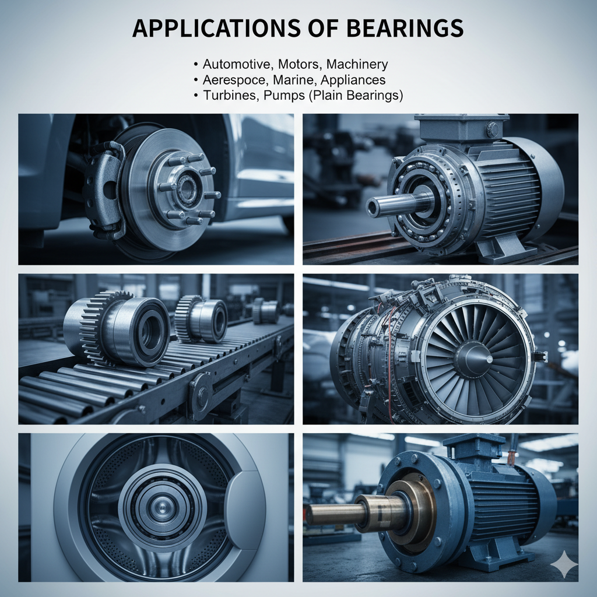
Bearings are used in a wide range of applications, including: - Automotive industry (wheels, engines, gearboxes) - Electric motors and generators - Industrial machinery and conveyors Aerospace and marine systems - Household appliances (fans, washing machines) Plain bearings, specifically, are used in turbines, pumps, and heavy-duty machinery where simplicity and reliability are needed
Common Applications:
• Automotive industry – wheels, engines, gearboxes.
• Electric motors, generators, and pumps.
• Industrial machinery, conveyors, and turbines.
• Aerospace and marine systems.
• Household appliances – fans, washing machines.
• Plain bearings: used in heavy-duty machinery and turbines for reliability

Slide 12
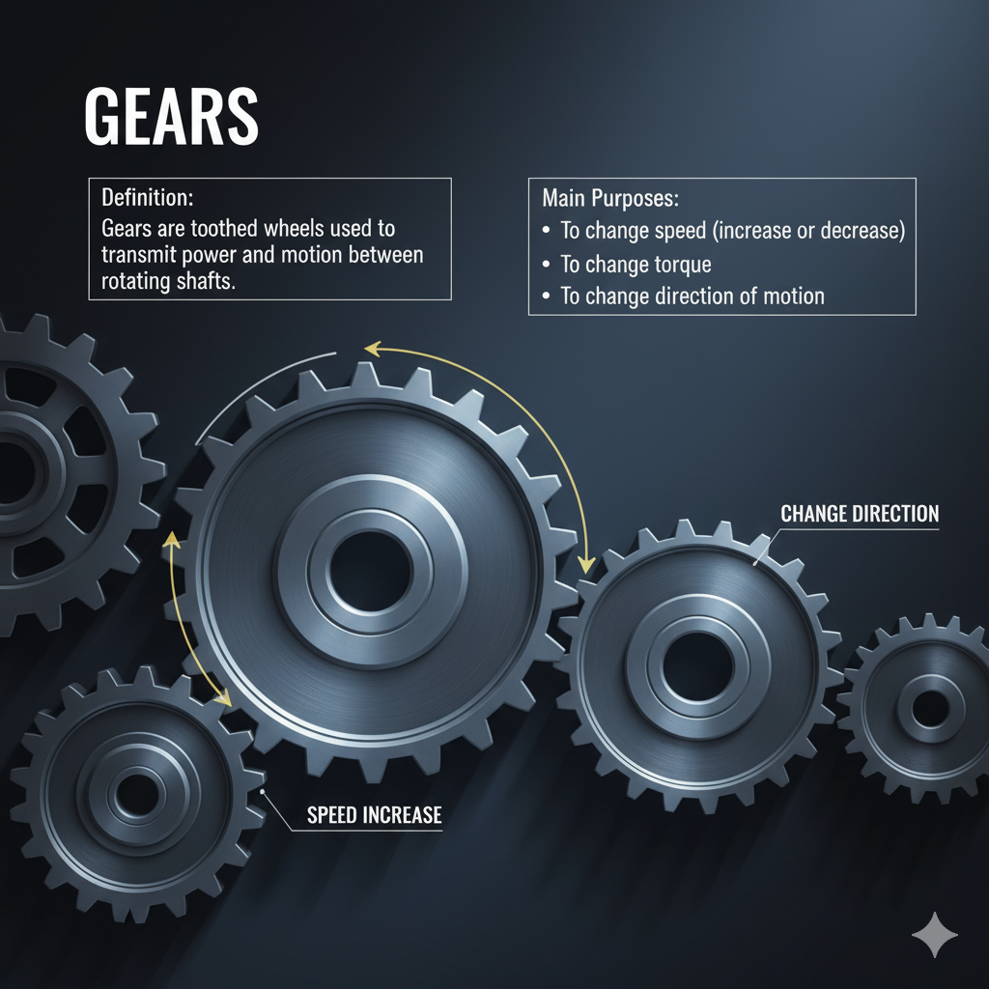
Main Purposes: To change speed (increase or decrease)To change torque To change direction of motion
Main Purposes:
To change speed (increase or decrease)
To change torque
To change direction of motion

Slide 13
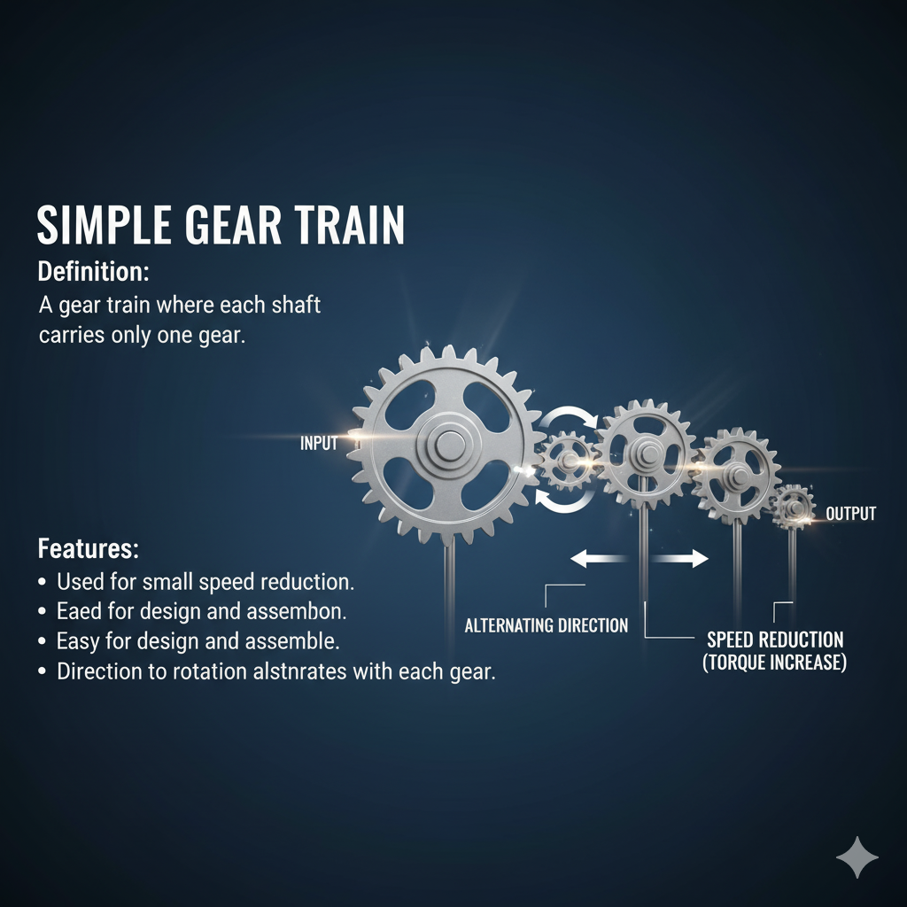
A gear train where each shaft carries only one gear.
Features:
Used for small speed reduction.
Easy to design and assemble.
Direction of rotation alternates with each gear.

Slide 14
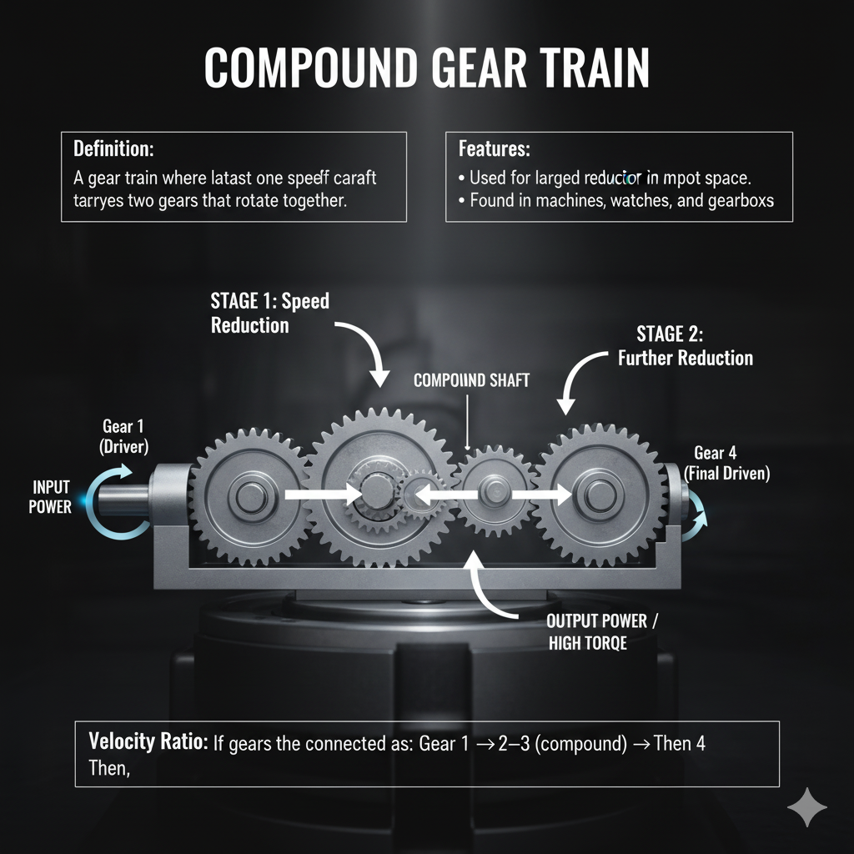
A gear train where at least one shaft carries two gears that rotate together.
Features:
Used for large speed reduction in a compact space.
Found in machines, watches, and gearboxes.
Velocity Ratio: If gears are connected as: Gear 1 → Gear 2–3 (compound) → Gear 4

